Slide 1
Syllable Deletion game

Slide 2
Say the word DOGHOUSE
Now say it again without the word house
What do you get?

Slide 3
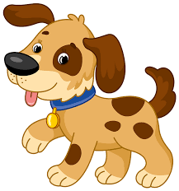
Dog

Slide 4
Say the word Lipstick
Now say it again without the word lip
What do you get?

Slide 5
Stick

Slide 6
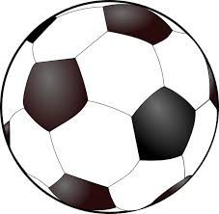
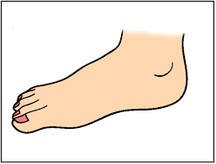
Say the word Football
Now say it again without the word foot
What do you get?

Slide 7
Ball

Slide 8
Say the word Snowman
Now say it again without the word man
What do you get?

Slide 9
Snow

Slide 10
Say the word Policecar
Now say it again without the word police
What do you get?

Slide 11
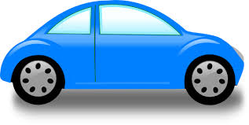
Car

Slide 12
Say the word Sunflower
Now say it again without the word sun
What do you get?

Slide 13
Flower

Slide 14
Well Done

